Slide 1
Classification
By Aggie Data Science Club (ADSC)

Slide 2
Part 1: Variables
By the Aggie Data Science Club :)
View or Clone Repository from Github:
https://github.com/aggiedatascience/classification
git clone https://github.com/aggiedatascience/classification.git

Slide 3
Qualitative vs Quantitative
Qualitative: Non-numerical
Ordinal
Something that can be ranked/Ordered
Ex. Associates, Bachelors, Masters, PhD
Nominal
Can be fit into different categories
Ex. Blood type A, B, AB, O
Quantitative: Numerical
Discrete vs continuous
Ex. Discrete - students at Tamu. Continuous- Time

Slide 4
Part 2: Encoding
By the Aggie Data Science Club :)
View or Clone Repository from Github:
https://github.com/aggiedatascience/classification
git clone https://github.com/aggiedatascience/classification.git

Slide 5
What is Encoding?
convert qualitative data into a numerical format that’s usable in ML models
Label Encoding:
Better for ordinal data
Ex: taco bell sauces (mild, hot, fire, diablo)
Ex: Do you like to code? (yes or no)
Can lead to incorrect predictions when there isn’t an ordinal relationship
red(1), blue(2), green(3) -> misleads the model
One-Hot Encoding:
Creates binary columns
Removes ordinal assumption
Can lead to “curse of dimensionality”
Frequency Encoding:
Replaced with the percentage that specific value is shown in the data
red( 50%), blue(25%), green(25%)
Qualitative Data
People | Fav Color
Bob | Red
Molly | Blue
Steve | Green
Amy | Red
One-Hot Encoding
People | Fav Color (Red) | Fav Color (Blue) | Fav Color (Green)
Bob | 1 | 0 | 0
Molly | 0 | 1 | 0
Steve | 0 | 0 | 1
Amy | 1 | 0 | 0

Slide 6
Part 3: Classification
By the Aggie Data Science Club :)
View or Clone Repository from Github:
https://github.com/aggiedatascience/classification
git clone https://github.com/aggiedatascience/classification.git

Slide 7
Example Use Cases for Classification
Determining if someone should get a loan
Classifying email as spam or not spam
Determining whether or not someone died on the titanic

Slide 8
Loss Functions
All ML models are based around minimizing a loss function (also known as objective function)
Different loss functions for different methods and tasks

Slide 9
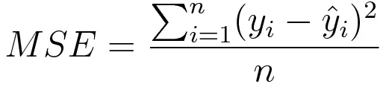
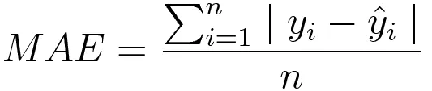
Common Loss Functions (Regression)
AKA L2 loss. Sensitive to outliers, but easier to compute
AKA L1 loss. Harder to compute, but more resistant to outliers

Slide 10
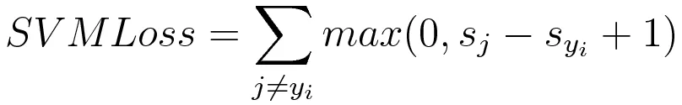
Common Loss Functions (Classification)

Slide 11
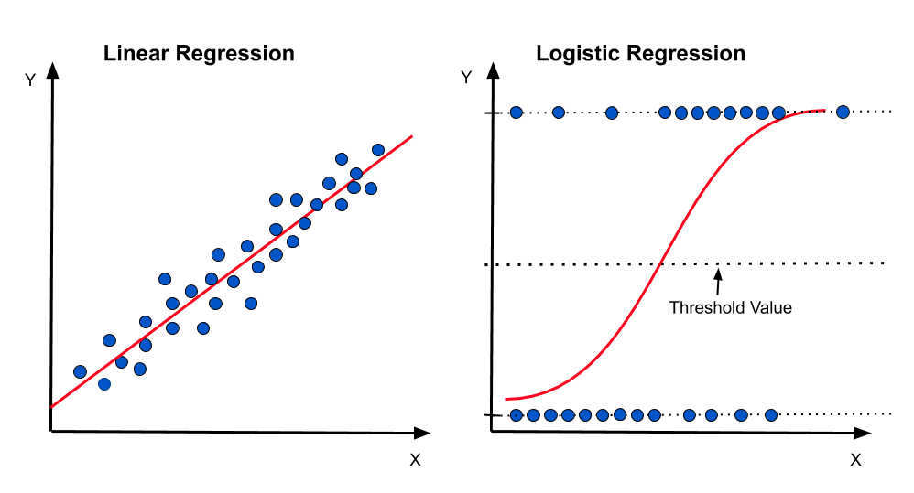
Logistic Regression
Not actually regression
Outputs a probability
Above 50%, class is 1, below 50%, class is 0
Very simple and well performing
Oftentimes as good as very complicated models
Explainable

Slide 12
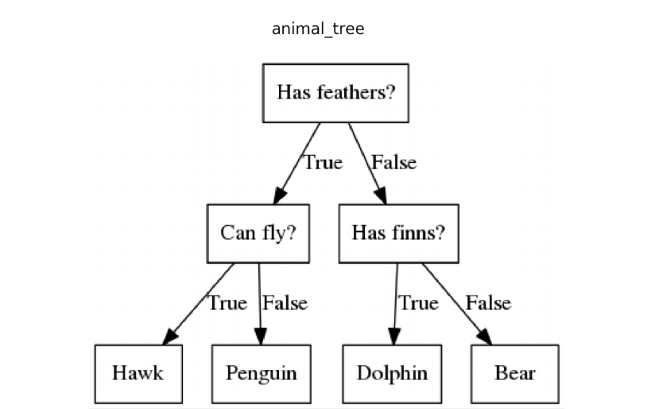
Decision Trees
Decide on splitting criteria based on Gini information gain or Shannon entropy
Very interpretable
At inference time, follow the decision tree

Slide 13
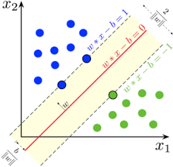
Support Vector Machine
Based on Maximum Margin

Slide 14
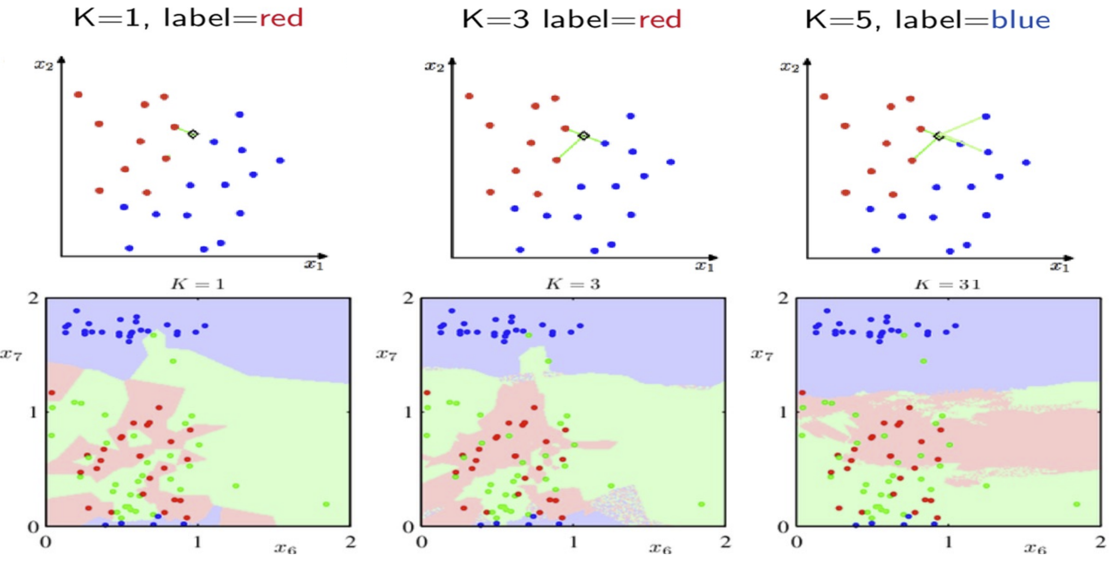
K-Nearest Neighbor
Regional classifier
Number of neighbors is tunable

